Slide 1



In-Memory Optimization (OLTP) enhancements overview
Mission-critical performance
with Microsoft SQL Server 2016
Speaker Name

Slide 2

Learning objectives
Overview of In-Memory OLTP
Enhancements to In-Memory OLTP
Benefits and best practices
In-Memory OLTP hands-on lab

Slide 3
Overview of
In-Memory OLTP

Slide 4

Why In-Memory OLTP?
Customers are demanding ever-higher concurrency and lower latency, at a lower cost
Hardware trends demand architectural changes to the relational database management system (RDBMS) to meet those demands
In-Memory Online Transaction Processing (OLTP), a key new feature of SQL Server 2016, offers:
    High performance
    Memory-optimized OLTP engine
    SQL Server integration
    Modern hardware architecture

Slide 5
Why In-Memory OLTP? (continued)
In-Memory OLTP is a memory-optimized database engine integrated into the SQL Server engine, optimized for OLTP, that can significantly improve database application performance
Features of In-Memory OLTP include:
    Memory-optimized tables
    Natively compiled stored procedures

Slide 6
Why In-Memory OLTP? (continued)
Memory-optimized table
  A memory-optimized table has one representation of itself in active memory, in addition to standard representation on hard drive
  Business transactions against a table run faster because they directly interact with only representation in active memory
  Natively compiled stored procedures
  A natively compiled stored procedure is a SQL Server object that can access only memory-optimized data structures (memory-optimized tables, table variables, etc.)
  Natively compiled stored procedures require fewer machine instructions during runtime than they would if they were created as traditional interpreted stored procedures

Slide 7
In-Memory OLTP value proposition
Target scenarios: OLTP apps with high throughput and low-latency requirements
Extreme OLTP performance (up to 30x) due to two factors:
    High scalability through lock- and latch-free architecture enables linear scaling
    Low latency through efficient data access and query processing: memory-optimized data structures and native compilation
Integrated into SQL Server for low total cost of ownership (TCO)
    Part of Enterprise Edition
    Same databases can have in-memory and on-disk
    Integrated developer and DBA experience: same T-SQL, client stack, tooling, backup/restore, AlwaysOn

Slide 8
In-Memory OLTP enhancements
Better T-SQL coverage, including:
  Full collations support in native modules
  Query surface-area improvements
  Nested stored procedures (EXECUTE)
  Natively compiled scalar user-defined functions
  Query Store support
Other improvements:
  Full schema change support: add/alter/drop column/constraint
  Increased size allowed for durable tables
  ALTER TABLE support
  Multiple Active Results Sets (MARS) support
ALTER TABLE Sales.SalesOrderDetail
ALTER INDEX PK_SalesOrderID
REBUILD
WITH (BUCKET_COUNT=100000000)
T-SQL surface area: New
  {LEFT|RIGHT} OUTER JOIN
  Disjunction (OR, NOT)
  UNION [ALL]
  SELECT DISTINCT
  Subqueries (EXISTS, IN, scalar)

Slide 9
Enhancements to In-Memory OLTP

Slide 10
Altering memory-optimized tables
| ADD
{
<column_definition>
| <table_constraint>
| <table_index>
} [ ,...n ]
| DROP
{
[ CONSTRAINT ]
{
constraint_name
} [ ,...n ]
| COLUMN
{
column_name
} [ ,...n ]
| INDEX
{
index_name
} [ ,...n ]
} [ ,...n ]
| ALTER INDEX index_name
{
REBUILD (WITH <rebuild_index_option>)
}
}
<rebuild_index_option> ::=
BUCKET_COUNT = bucket_count
)
ALTER TABLE syntax is used for making changes to table schema, as well as for adding, deleting, and rebuilding indexes
Indexes are considered part of table definition
Ability to change the BUCKET_COUNT with an ALTER INDEX statement

Slide 11
Altering natively compiled stored procedures
CREATE PROCEDURE [dbo].[usp_1]
WITH NATIVE_COMPILATION, SCHEMABINDING, EXECUTE AS OWNER
AS BEGIN ATOMIC WITH
(
TRANSACTION ISOLATION LEVEL = SNAPSHOT, LANGUAGE = N'us_english'
)
SELECT c1, c2 from dbo.T1
END
GO
ALTER PROCEDURE [dbo].[usp_1]
WITH NATIVE_COMPILATION, SCHEMABINDING, EXECUTE AS OWNER
AS BEGIN ATOMIC WITH
(
TRANSACTION ISOLATION LEVEL = SNAPSHOT, LANGUAGE = N'us_english'
)
SELECT c1 from dbo.T1
END
GO
You can now perform ALTER operations on natively compiled stored procedures using ALTER PROCEDURE statement
Use sp_recompile to recompile stored procedures on next execution

Slide 12
Greater Transact-SQL coverage
CREATE PROCEDURE (Transact-SQL)
DROP PROCEDURE (Transact-SQL)
ALTER PROCEDURE (Transact-SQL)
SELECT (Transact-SQL) and INSERT SELECT statements
SCHEMABINDING and BEGIN ATOMIC (required for natively compiled stored procedures)
NATIVE_COMPILATION
Parameters and variables can be declared as NOT NULL
Table-valued parameters.
GRANT and DENY permissions on tables and procedures.
Nesting natively compiled stored procedures
RIGHT OUTER JOIN, LEFT OUTER JOIN, INNER JOIN, and CROSS JOIN in SELECT statements
NOT, OR, and IN operators in SELECT, UPDATE and DELETE statement
UNION ALL and UNION
SELECT DISTINCT
GROUP BY clause with no aggregate functions in the SELECT clause (<select> list).
COLUMNSTORE
COLLATE

Slide 13
Improved scaling
Other enhancements include:
Multiple threads to persist memory-optimized tables
  Multi-threaded recovery
MERGE operation
  Dynamic management view improvements to sys.dm_db_xtp_checkpoint_stats and sys.dm_db_xtp_checkpoint_files
The In-Memory OLTP engine has been enhanced to scale linearly on servers up to four sockets

Slide 14
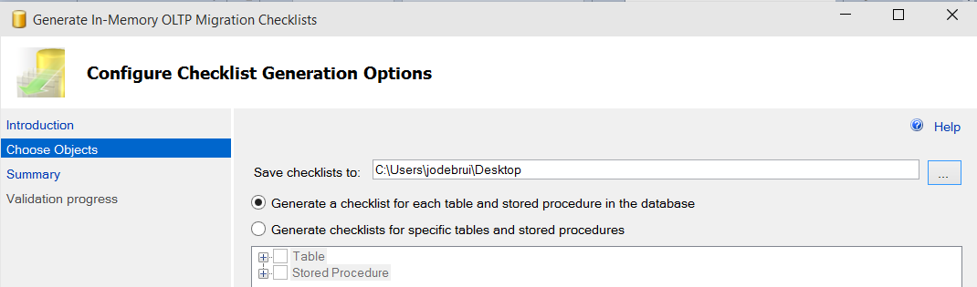
Improvements in Management Studio
Lightweight performance analysis
  Transaction Performance Analysis report pinpoints hot spots in app
Migration checklists
  Migration checklists show unsupported features used in current disk-based tables and interpreted
  T-SQL stored procedures
  Generates checklists for all or some tables and procedures
  Uses GUI or PowerShell

Slide 15
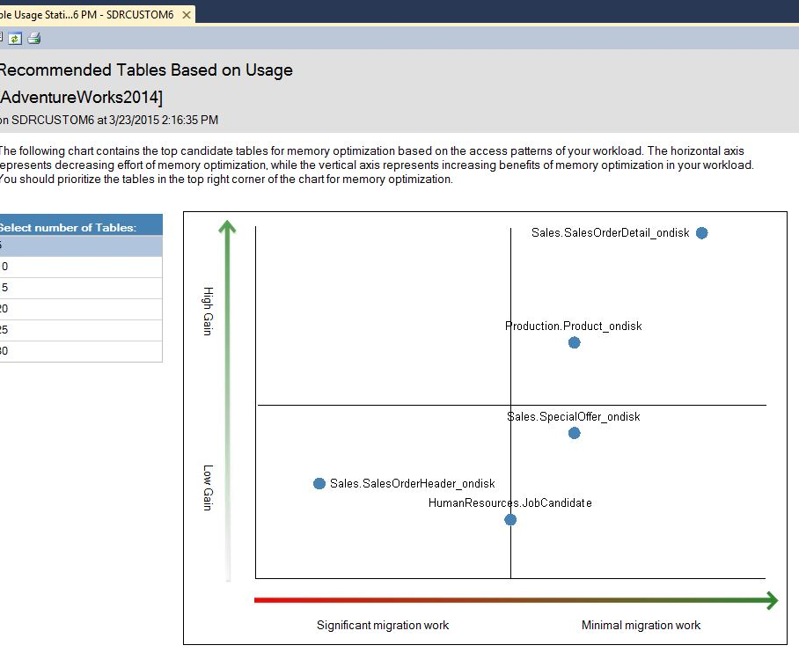
New transaction performance analysis overview report
New report replaces need to use Management Data Warehouse to analyze which tables and stored procedures are candidates for In-Memory OLTP

Slide 16
Using multiple active result sets
  Setup MARS connection for memory optimized tables using MultipleActiveResultsSets=True in your connection string
Data Source=MSSQL; Initial Catalog=AdventureWorks; Integrated Security=SSPI; MultipleActiveResultSets=True

Slide 17
Support for Transparent Data Encryption
Transparent Database Encryption (TDE) architecture
Windows Operating System
level-data protection
  In SQL Server 2016, storage for memory-optimized tables will be encrypted as part of enabling TDE on database
  Simply follow same steps as you would for a disk-based database
DPAPI encrypts Service Master Key
SQL Server
instance level
Created at time of SQL Server setup
Service Master Key
Service Master Key encrypts Database Master Key for master database
Master
database level
Statement:
CREATE MASTER KEY…
Database Encryption Key
Database Master Key of master database creates certificate in master database
Statement:
CREATE CERTIFICATE…
Certificate encrypts Database Encryption Key in user database
User database
level
Statement:
CREATE DATABASE ENCRYPTION KEY…
Database Encryption Key
Entire user database is secured by Database Encryption Key of user database with transparent database encryption
Statement:
ALTER DATABASE… SET ENCRYPTION0.

Slide 18
Benefits and
best practices

Slide 19
Benefits
This table summarizes workload patterns that may benefit most with In-Memory OLTP
Implementation scenario | Implementation scenario | Benefits of In-Memory OLTP
High-data insertion rate from multiple concurrent connections | Primarily append-only store Unable to keep up with insert workload | Eliminate contention Reduce logging
Read performance and scale with periodic batch inserts and updates | High-performance read operation, especially when each server request has multiple read operations to perform Unable to meet scale-up requirements | Eliminate contention when new data arrives Lower latency data retrieval Minimize code execution time
Intensive business logic processing in database server | Insert, update, and delete workload Intensive computation inside stored procedures Read and write contention | Eliminate contention Minimize code execution time for reduced latency and improved throughput
Low latency | Low-latency business transaction required, which typical database solutions can’t achieve | Eliminate contention Minimize code execution time Low-latency code execution Efficient data retrieval
Session state management | Frequent insert, update, and point lookups High-scale load from numerous stateless web servers | Eliminate contention Efficient data retrieval Option IO reduction or removal, when using non-durables tables

Slide 20
Other benefits and best practices
When to use In-Memory OLTP to improve performance
  Short-running transactions
  Programming patterns including concurrency scenarios, point lookups, and workloads in which there are many inserts and updates, and business logic in stored procedures
How In-Memory OLTP improves performance and scalability
  Optimized algorithms to access memory-resident data
  Optimistic concurrency control that eliminates logical locks
  Natively compiled stored procedures, with better performance than interpreted stored procedures for accessing memory-optimized tables

Slide 21
Hands-on lab (HOL)

Slide 22

© 2015 Microsoft Corporation. All rights reserved. Microsoft, Windows, Microsoft Azure, and other product names are or may be registered trademarks and/or trademarks in the U.S. and/or other countries. The information herein is for informational purposes only and represents the current view of Microsoft Corporation as of the date of this presentation. Because Microsoft must respond to changing market conditions, it should not be interpreted to be a commitment on the part of Microsoft, and Microsoft cannot guarantee the accuracy of any information provided after the date of this presentation. MICROSOFT MAKES NO WARRANTIES, EXPRESS, IMPLIED OR STATUTORY, AS TO THE INFORMATION IN THIS PRESENTATION

